Slide 1
Introduction to using R
Imperial College London

Slide 2
Contents
Variables
Data Types
Strings
Operators
Conditional statements
Loops

Slide 3
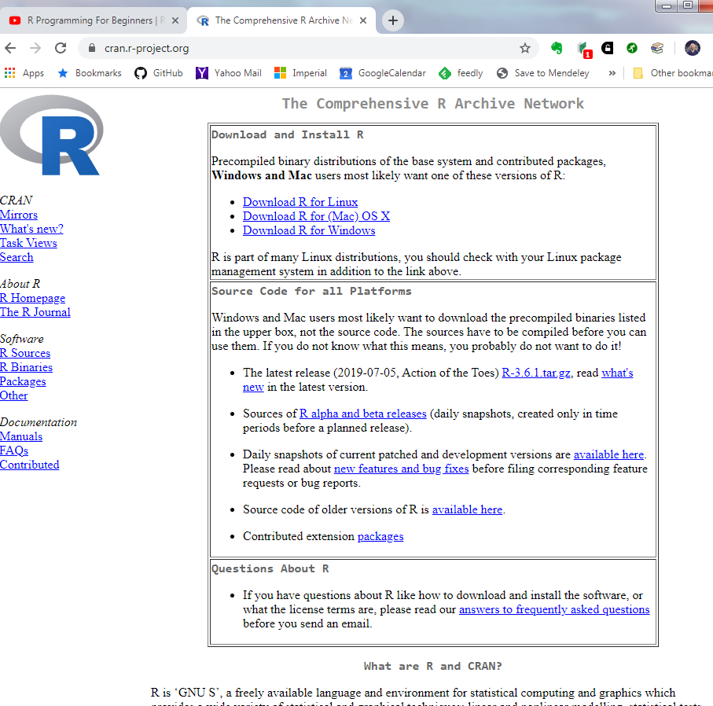
Download R
Notes:
Base version
Corrects OS

Slide 4
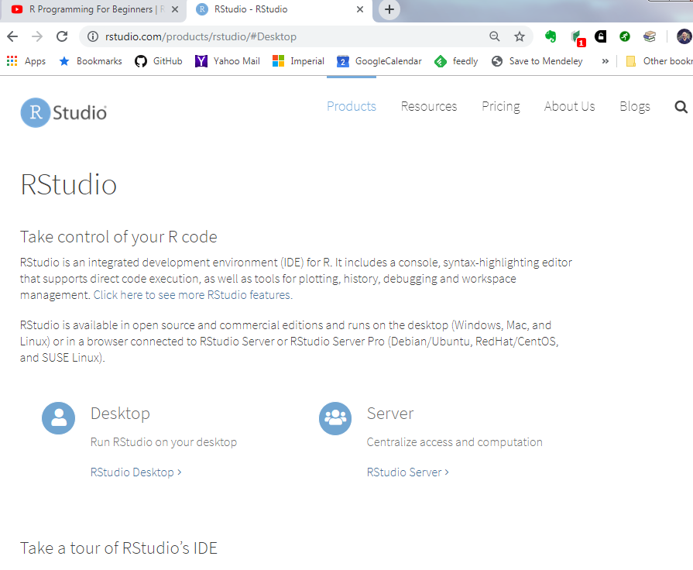
Download RStudio
Notes:
Desktop version which is free

Slide 5



Diving in!
We can get output simply by typing maths in to the console
More interesting is assigning values to variables or objects
Use the <- operator (more later)

Slide 6
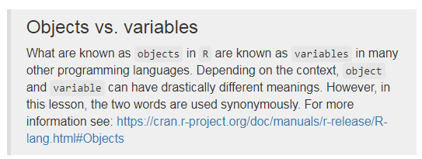

Slide 7
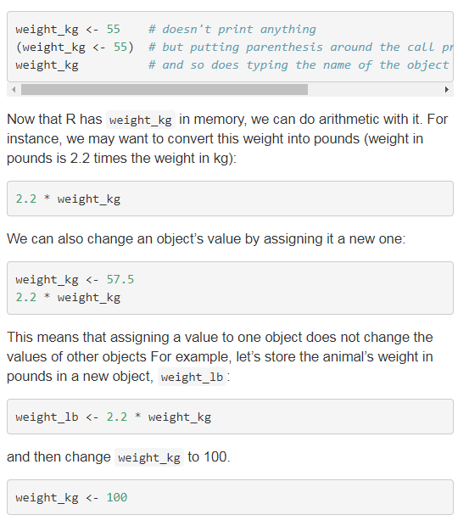

Slide 8
Comments
The comment character in R is #, anything to the right of a # in a script will be ignored by R. It is useful to leave notes and explanations in your scripts. RStudio makes it easy to comment or uncomment a paragraph:
Press to comment/uncomment a line

Slide 9

Functions and their arguments
Automate more complicated sets of commands, as a black-box
Available by importing packages
A functions has arguments and can return a value
Executing or running a function is called calling the function
Notes:
Here, the value of a is given to the sqrt() function, the sqrt() function calculates the square root, and returns the value which is then assigned to the object b. This function is very simple, because it takes just one argument.
The return ‘value’ of a function need not be numerical (like that of sqrt()), and it also does not need to be a single item: it can be a set of things, or even a dataset. We’ll see that when we read data files into R.
Arguments can be anything, not only numbers or filenames, but also other objects. Exactly what each argument means differs per function, and must be looked up in the documentation (see below). Some functions take arguments which may either be specified by the user, or, if left out, take on a default value: these are called options. Options are typically used to alter the way the function operates, such as whether it ignores ‘bad values’, or what symbol to use in a plot. However, if you want something specific, you can specify a value of your choice which will be used instead of the default.

Slide 10
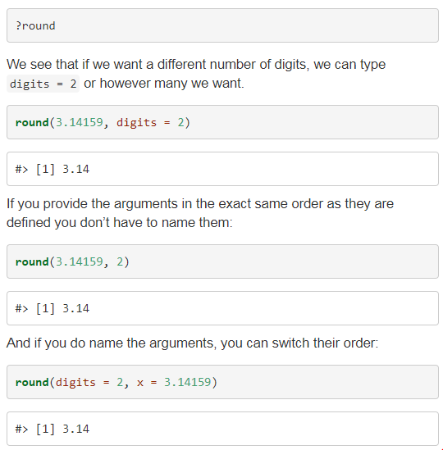
Multiple arguments

Slide 11
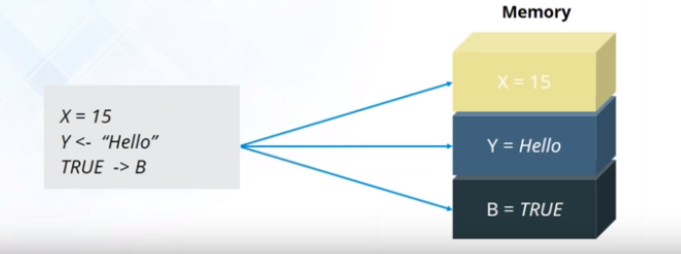
Variables
Variable are reserved memory locations to store values.
Notes:
Who has an idea of what variables are

Slide 12
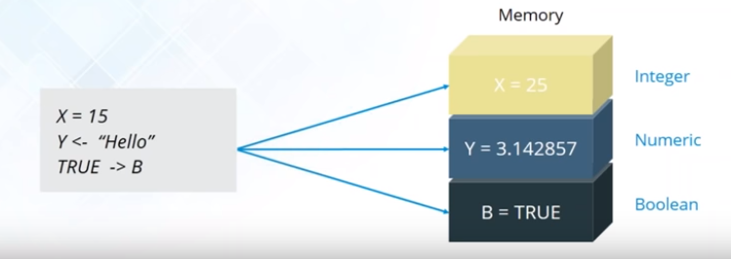
Data types
A classification that specifies which type of value a variable has and what type of mathematical, relational or logical operations can be applied to it without causing an error

Slide 13
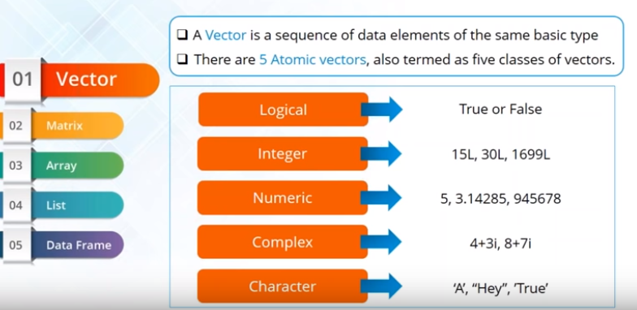
Vector
Notes:
Give examples in Rstudio demo
L

Slide 14
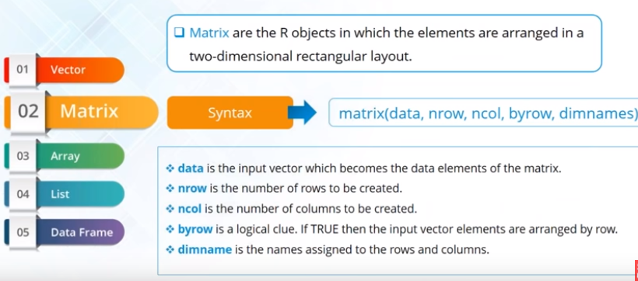
Matrix

Slide 15
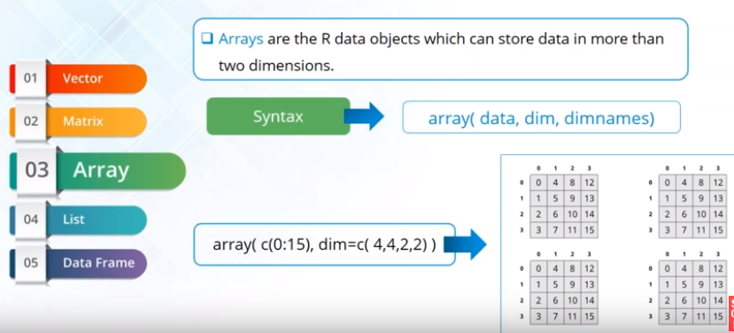
Array

Slide 16
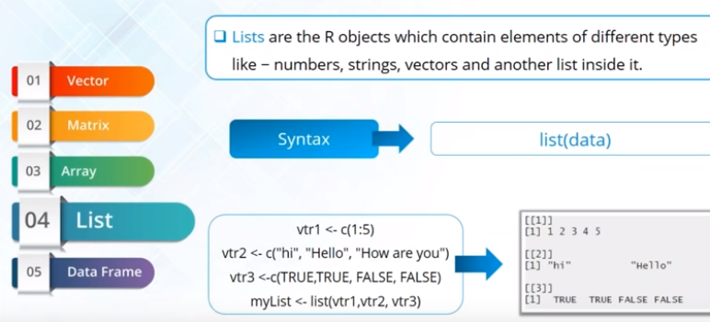
Lists

Slide 17
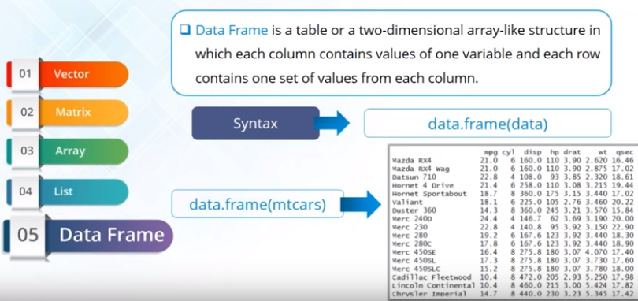
Data Frame

Slide 18
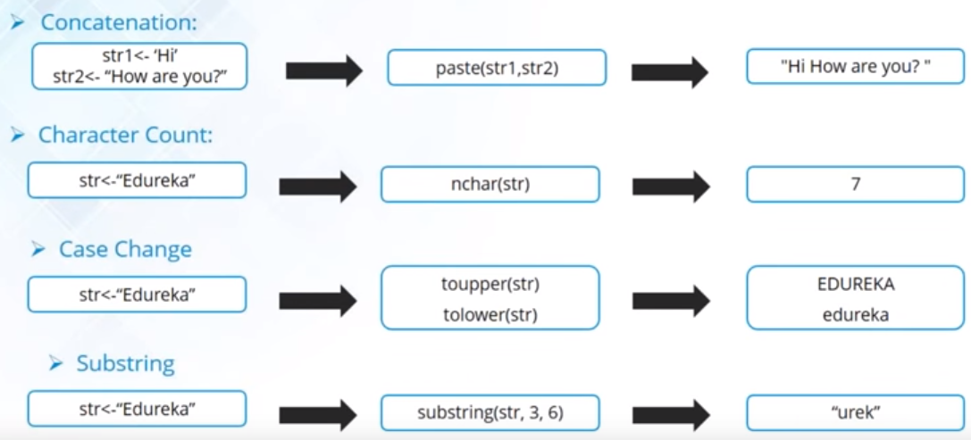
Strings
Any value written with a pair of single of double quotes

Slide 19
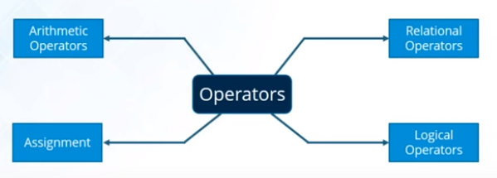
Operators
Constructs that can manipulate the value of operands

Slide 20
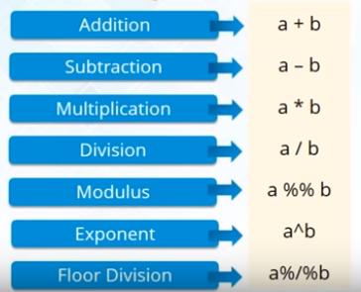
Arithmetic

Slide 21
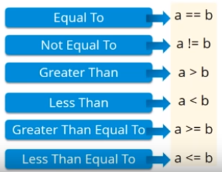
Relational

Slide 22
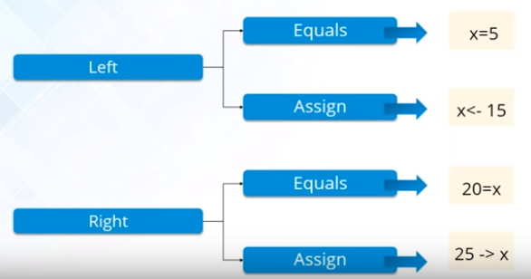
Assignment
Left and Right

Slide 23
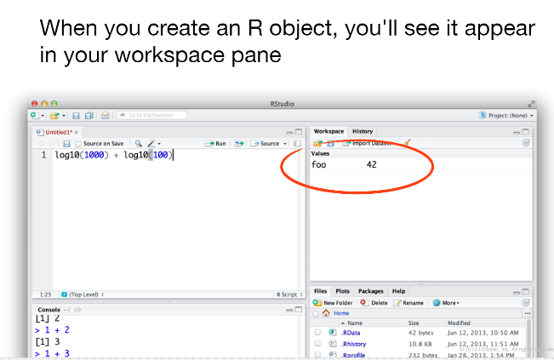

Slide 24
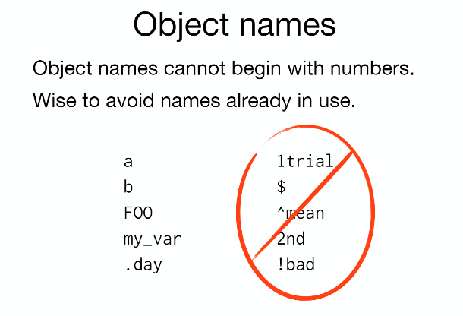

Slide 25
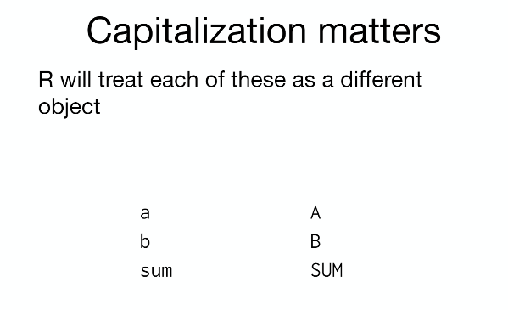

Slide 26
More tips for variable names
Make your names explicit and not too long.
Avoid names of fundamental functions in R
e.g., if, else, for, see here for a complete list). In general, even if it’s allowed, it’s best to not use other function names (e.g., c, T, mean, data) as variable names. When in doubt check the help to see if the name is already in use.
Avoid dots (.) within a variable name as in my.dataset
There are many functions in R with dots in their names for historical reasons, but because dots have a special meaning in R (for methods) and other programming languages, it’s best to avoid them.
Use nouns for object names and verbs for function names
Be consistent with the styling of your code (where you put spaces, how you name variable, etc.)
In R, two popular style guides are Hadley Wickham’s style guide and Google’s.

Slide 27
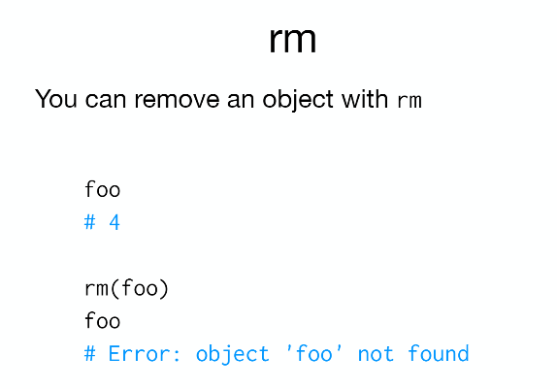

Slide 28
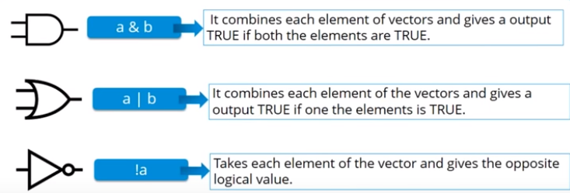
Logical
3 types: AND, NOT, OR

Slide 29
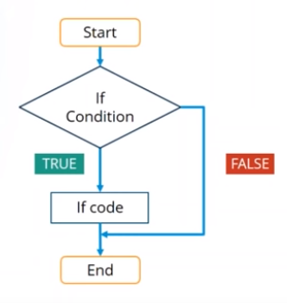

Conditional statements
if statement

Slide 30
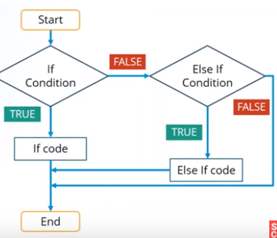
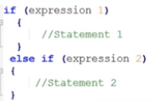
Else-if statement

Slide 31
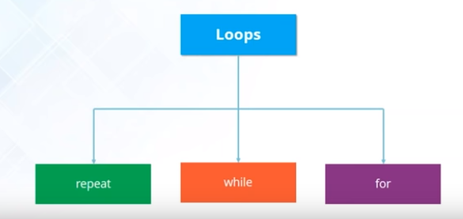
Loops
Allows us to execute a statement or group of statements multiple times.

Slide 32
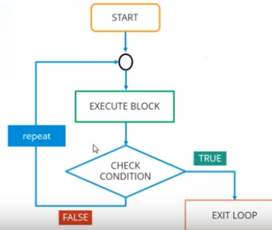

Repeat
Test condition AFTER executing body

Slide 33
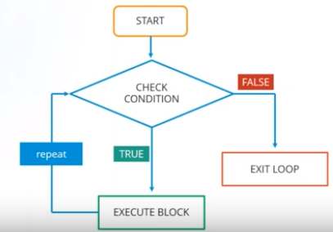

While
Test condition BEFORE executing body

Slide 34
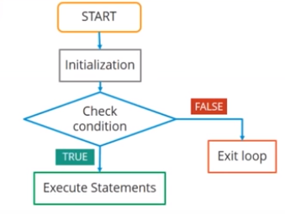

For loop
Repeats body a fixed number of times

